Slide 1
IEEE Pokemon Raspberry Pi
The Game

Slide 2
How this all works
One computer (this time my laptop) is the “Main Server”
All Pi’s are running a server as well
Pi’s also have calls to talk to main server
All device are connected on same router
This allows to talk to each other

Slide 3
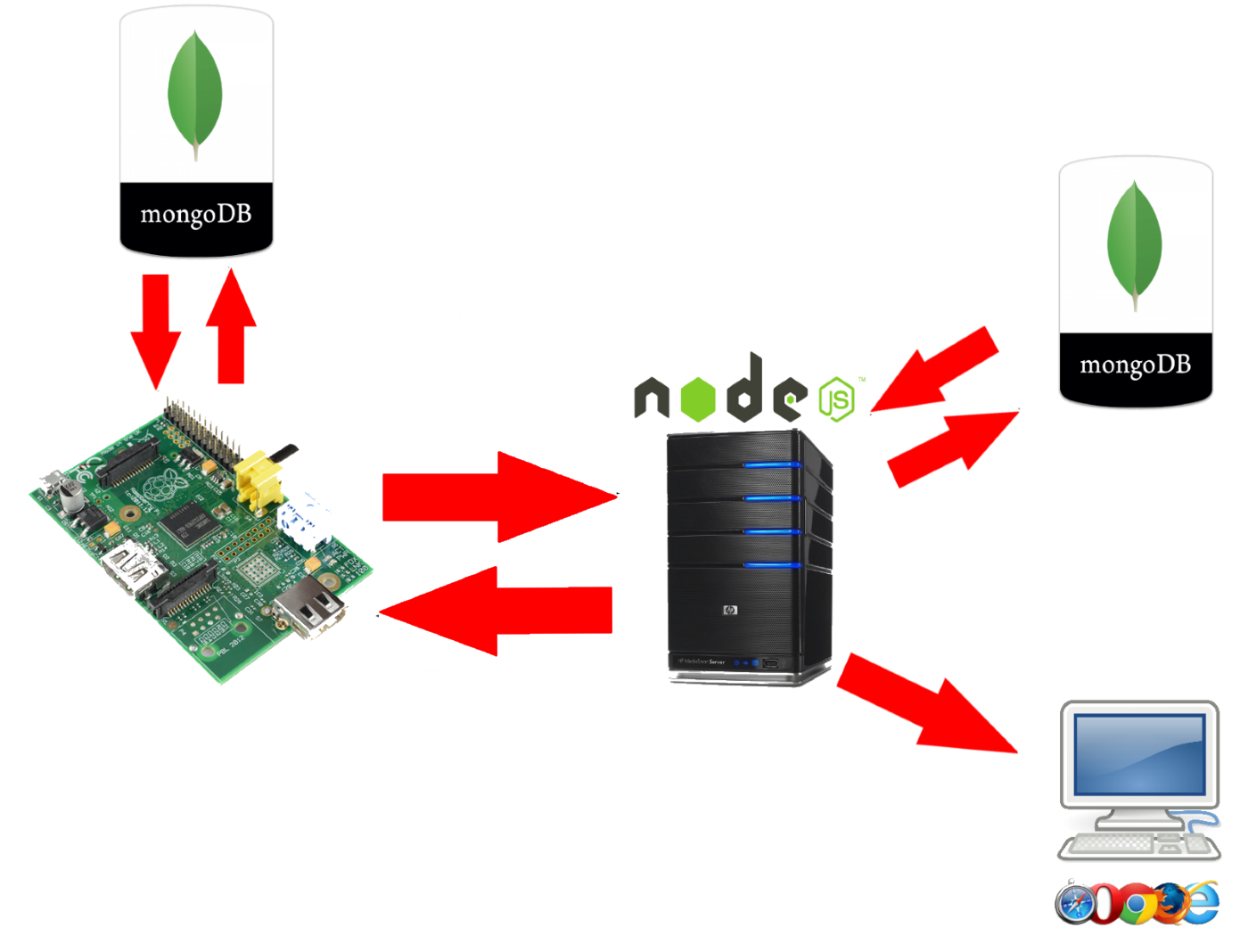

Slide 4
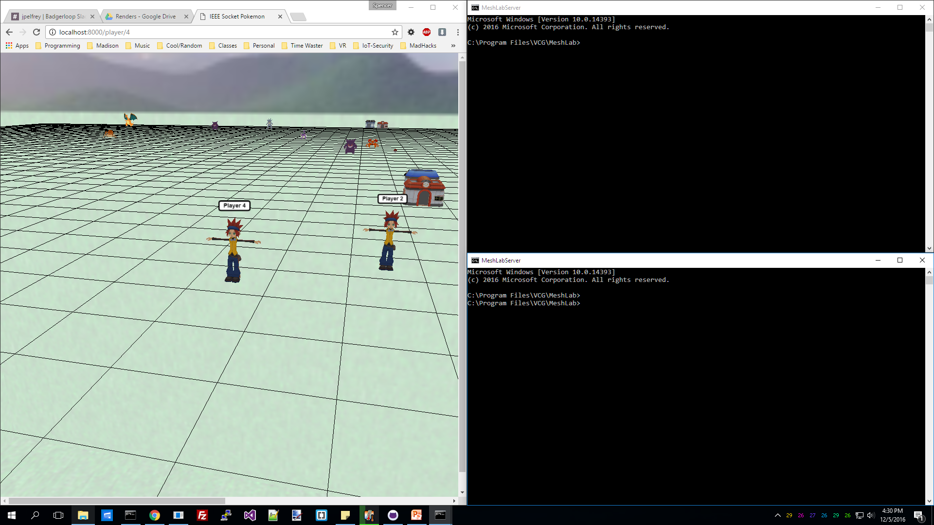
How to run the game

Slide 5
How to run the game
The web view
A “Read-only” interface
Real time updates

Slide 6
How to run the game
The Client View
A terminal screen to make client request
The “Game Controller”

Slide 7
How to run the game
The Pi Server
Runs a server on Pi until you stop the instance
Lets you monitor action being sent

Slide 9
The setup
First get the latest code
Go the /home/pi/IEEE/Pi
Run git pull
Grabs the repo from Pi up front

Slide 10
The Setup
Update server ip
Go to the ‘client’ folder
Edit util.h (Vi and Nano are installed)
nano util.h
Set IP to:
“ctrl+x” to exit
Hit enter to save changes
Hit enter again to save to same name

Slide 11
The Setup
Update server ip
Go to the ‘database’ folder /home/pi/IEEE/database
Run ./setupMongoScript
If permission are denied run chmod +x ./setupMongoScript

Slide 12
The Setup
Make files
Go back to the parent folder /home/pi/IEEE/Pi
Run make
Can run make clean to clear executables

Slide 13
Lets Do this!
In your server terminal run the runServer executable
That’s it, you are host your own server

Slide 14
Time to login
In your client terminal you have 4 programs
Login
Move
Stats
Options
To run any just go ./move [direction]

Slide 15
How to use these
Login
./login to sign into the game
Move
./move [direction] to move player
Option
./option [number] used for battle and at mart
Stats
./stats [me, all, or a number] shows stats of player

Slide 16
The Point of the Game
Score the most points
Points are scored by capturing pokemon
If you kill it you get 25% of the point value
If you die you restart in the center and lose 20% of your points…and partially lag the server

Slide 17





5000 points
Rest of Pokemon are worth 200-1000 points
NOTE: The more they are worth, the harder it is to catch
Also Mewtwo deals good damage
3000 points
2000 points
2000 points
1200 points

Slide 18

Poke Center
Heals you to full health
Just step on top of it
In center of map and all edges of map

Slide 19
Items
Used during battle only
Can be bought with coins
For every point you score you get a coin

Slide 20
Items
Pokeball
Good chance of capturing pokemon
Greatball
Better chance of capturing pokemon
Ultraball
Best chance of capturing pokemon
Potion
Heals your health by 25
Super Potion
Heals your health by 50

Slide 21

Poke Mart
Can buy pokeballs and potions
Stand on top to buy items
There is one next to every PokeCenter

Slide 22

Pokeball
There are a few scatter balls for free on the field
First come first serve

Slide 23
Last things to note
The game is live, so get to the pokemon first
If you run or die in battle pokemon health stay were you got it to
Your server terminal needs to be up at all times
Press “X” on your browser to see your current stats
Might still be a few glitches

